Slide 1
Planning and Managing the Project: Effort Estimation

Slide 2
Effort Estimation
Estimating project costs is one of the crucial aspects of project planning and management
Estimating cost has to be done as early as possible during the project life cycle

Slide 3
Types of Costs
Facilities: hardware, space, furniture, telephone, etc.
Software tools for designing software
Staff (effort): the biggest component of cost

Slide 4
Software Project Estimation
S/W cost and effort estimation will never be an exact science
Too many variables
Human
Technical
Environmental
Political

Slide 5
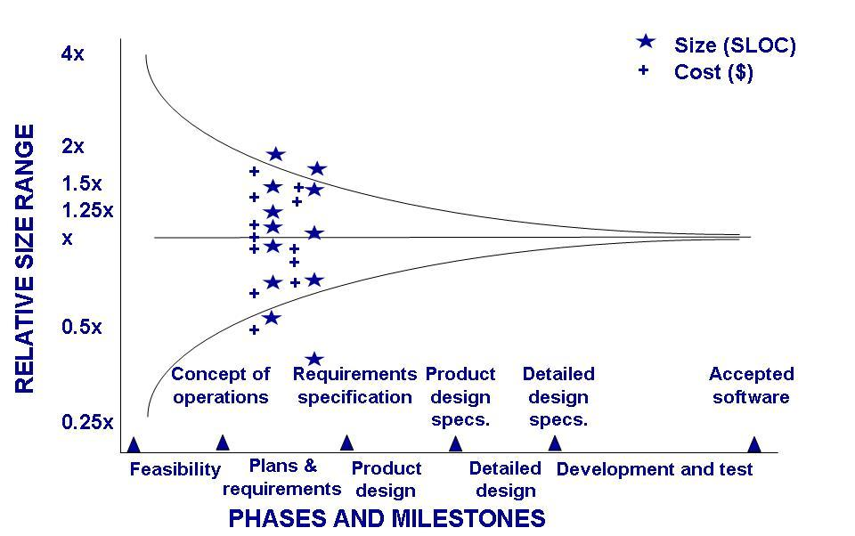
Effort Estimation Estimation Should be Done Repeatedly
Uncertainty early in the project can affect the accuracy of cost and size estimations

Slide 6
Pre-requisite to Estimating Effort
Understand the scope of the project to be built
Generate an estimate of size

Slide 7
Estimating Size
The accuracy of a s/w project estimate is predicated on a number of things:
The degree to which the planner has properly estimated the size of the product to be built
The ability to translate the size estimate into human effort, calendar time, and dollars (required availability of past records)
The degree to which the project plan reflects the abilities of the s/w team
The stability of product requirements and the environment that supports the s/w engineering effort

Slide 8
Estimating Size
Sizing represents the project planner’s first major challenge
Size refers to a quantifiable outcome of the s/w project (e.g. LOC and/or FP)

Slide 9
Estimating Size and Effort
Example of baseline productivity metrics are LOC/pm or FP/pm

Slide 10
An Example
Software Module | Estimated LOC
User interface and control facilities (UICF) Two-dimensional geometric analysis (2DGA) Three-dimensional geometric analysis (3DGA) Database management (DBM) Computer graphics display facilities (CGDF) Peripheral control function (PCF) Design analysis modules (DAM) | 2,300 5,300 6,800 3,350 4,950 2,100 8,400
Estimated lines of code | 33,200
Effort?
Productivity?

Slide 11
An Example of LOC-Based Estimation
Estimated lines of code = W = 33,200
Let,
Average productivity = X = 50 LOC/pd
Labor rate = Y = $100 per day
So,
Cost per line of code = Z = Y/X = $2
Total estimated project cost = W*Z = $66,400
Estimated effort = W/X = 664 person-days

Slide 12
An Example of LOC-Based Estimation
Estimated lines of code = W = 33,200
Let,
Average productivity = X = 600 LOC/pm
Labor rate = Y = $5000 per month
So,
Cost per line of code = Z = Y/X = ?
Total estimated project cost = W*Z = ?
Estimated effort = W/X = ?

Slide 13
3.3 Effort Estimation Sidebar 3.3 Causes of Inaccurate Estimates
Key causes
Frequent request for change by users
Overlooked tasks
User's lack of understanding of the requirements
Insufficient analysis when developing estimates
Lack of coordination of system development, technical services, operations, data administration, and other functions during development
Lack of an adequate method or guidelines for estimating

Slide 14
3.3 Effort Estimation Sidebar 3.3 Causes of Inaccurate Estimates (continued)
Key influences
Complexity of the proposed application system
Required integration with existing system
Complexity of the program in the system
Size of the system expressed as number of functions or programs
Capabilities of the project team members
Project team's experience with the application, the programming language, and hardware
Capabilities of the project team members
Database management system
Number of project team member
Extent of programming and documentation standards

Slide 15
Software Project Estimation
Base estimates on similar projects that have already been completed
Unfortunately, past experience has not always been a good indicator of future results but it helps
Use relatively simple decomposition techniques to generate project cost and effort estimates
“Divide and conquer” approach
Use one or more empirical models for software cost and effort estimation
Can be used as a cross-check for the previous option and vice versa

Slide 16
Decomposition Techniques
Decompose the problem into sub-problems
Understand the scope of the s/w to be built
Generate an estimate of its “size”

Slide 17
Estimating Size
A hierarchy of estimation models
Address the following areas
Application composition model
Early design stage model
Post-architecture stage model
Three different sizing options are available
Application points
Function points
Lines of source code

Slide 18


Effort Estimation COCOMO
Introduced by Boehm
COCOMO I
effort as a function of size
COCOMO II
updated version
effort as a function of size
Includes cost factors as a multiplier
include models of reuse
requires sizing information like all other models
COnstructive COst MOdel (COCOMO)

Slide 19
Effort Estimation COCOMO I
Effort (E) = a (KLOC)^{b} person_months
Development Time (D) = c x E ^{d} months
Organic: small teams, rigid requirements
Semi detached: medium teams, less rigid requirements
Embedded: combination of O and S (h/w, s/w,…)
S/W Type | a | b | c | d
Org | 2.4 | 1.05 | 2.5 | 0.38
Sdet | 3 | 1.12 | 2.5 | 0.35
Emb | 3.6 | 1.20 | 2.5 | 0.32

Slide 20
An Example
Software Module | Estimated LOC
User interface and control facilities (UICF) Two-dimensional geometric analysis (2DGA) Three-dimensional geometric analysis (3DGA) Database management (DBM) Computer graphics display facilities (CGDF) Peripheral control function (PCF) Design analysis modules (DAM) | 2,300 5,300 6,800 3,350 4,950 2,100 8,400
Estimated lines of code | 33,200
E?
D?
Productivity?

Slide 21
Effort Estimation COCOMO II: Stages of Development
Effort = b (S)^{c} m(x) person_months
Application composition
prototyping to resolve high-risk user interface issues
size estimates in application points
Early design
to explore alternative architectures and concepts
size estimates in function points
Postarchitecture
development has begun
size estimates in lines of code

Slide 22
Three Stages of COCOMO II

Slide 23
Estimating Size: Stage 1
Application points are computed using counts of the number of
Screens (at the user interface)
Reports
Components likely to be required to build the application

Slide 24
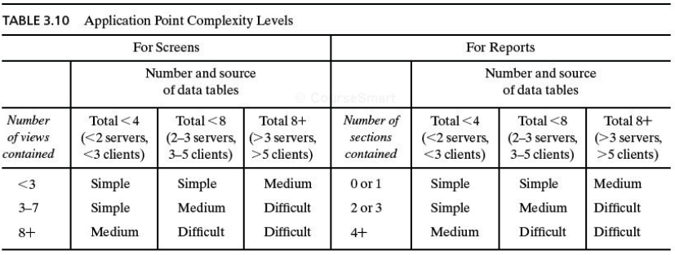
Estimating Size: Stage 1

Slide 25
Estimating Size: Stage 1
Object type | Complexity weight
 | Simple | Medium | Difficult
Screen | 1 | 2 | 3
Report | 2 | 5 | 8
Components |  |  | 10
Complexity weights for object types

Slide 26
Estimating Size: Stage 1
Developer’s experience/capability | Very low | Low | Nominal | High | Very High
Environment maturity/capability | Very low | Low | Nominal | High | Very High
PROD | 4 | 7 | 13 | 25 | 50
Productivity rate for object points

Slide 27
Estimation of Size
Example of baseline productivity metrics are LOC/pm or FP/pm
Making the use of single baseline productivity metric is discouraged
In general, LOC/pm or FP/pm averages should be computed by project domain
Local domain averages should be used

Slide 28
Estimating Size: Stage 2
Function Points (FP) Can be used effectively as a means for measuring the functionality delivered by a system
Using historical data, function points can be used to
Estimate the cost or effort required to design, code, and test the software
Predict the number of errors that will be encountered during testing
Forecast the number of components and/or the number of projected source code lines in the implemented system
Derived using an empirical relationship based on
Countable (direct) measures of the software’s information domain
Assessments of the software’s complexity
FP = count total * [0.65 + 0.01 * sum(F_{i})]

Slide 29
Introduction to Function Points
Information Domain Values
Number of external inputs
Number of external outputs
Number of external inquiries
Number of internal logical files
Number of external interface files
Value Adjustment Factors (VAF)
14 Factors

Slide 30
Information Domain Values
Number of external inputs
Each external input originates from a user or is transmitted from another application
They provide distinct application-oriented data or control information
They are often used to update internal logical files
They are not inquiries (those are counted under another category)
Number of external outputs
Each external output is derived within the application and provides information to the user
This refers to reports, screens, error messages, etc.
Individual data items within a report or screen are not counted separately

Slide 31
Information Domain Values (continued)
Number of external inquiries
An external inquiry is defined as an online input that results in the generation of some immediate software response
The response is in the form of an on-line output
Number of internal logical files
Each internal logical file is a logical grouping of data that resides within the application’s boundary and is maintained via external inputs
Number of external interface files
Each external interface file is a logical grouping of data that resides external to the application but provides data that may be of use to the application

Slide 32
Value Adjustment Factors
Does the system require reliable backup and recovery?
Are specialized data communications required to transfer information to or from the application?
Are there distributed processing functions?
Is performance critical?
Will the system run in an existing, heavily utilized operational environment?
Does the system require on-line data entry?
Does the on-line data entry require the input transaction to be built over multiple screens or operations?

Slide 33
Value Adjustment Factors (continued)
Are the internal logical files updated on-line?
Are the inputs, outputs, files, or inquiries complex?
Is the internal processing complex?
Is the code designed to be reusable?
Are conversion and installation included in the design?
Is the system designed for multiple installations in different organizations?
Is the application designed to facilitate change and for ease of use by the user?

Slide 34
Function Point Computation
Identify/collect the information domain values
Complete the table shown below to get the count total (aka unadjusted function points)
Associate a weighting factor (i.e., complexity value) with each count based on criteria established by the software development organization
Evaluate and sum up the adjustment factors (see example in the next few slides)
“F_{i}” refers to 14 value adjustment factors, with each ranging in value from 0 (not important) to 5 (absolutely essential)
Compute the number of function points (FP) aka Adjusted FP FP = count total * [0.65 + 0.01 * sum(F_{i})]
Information Weighting Factor
Domain Value Count Simple Average Complex
External Inputs _____ x 3 4 6 = _____
External Outputs _____ x 4 5 7 = _____
External Inquiries _____ x 3 4 6 = _____
Internal Logical Files _____ x 7 10 15 = _____
External Interface Files _____ x 5 7 10 = _____ Count total ________

Slide 35
Function Point Example
Information Weighting Factor
Domain Value Count Simple Average Complex
External Inputs 3 x 3 4 6 = 9
External Outputs 2 x 4 5 7 = 8
External Inquiries 2 x 3 4 6 = 6
Internal Logical Files 1 x 7 10 15 = 7
External Interface Files 4 x 5 7 10 = 20 Count total 50
FP = count total * [0.65 + 0.01 * sum(F_{i})]
FP = 50 * [0.65 + 0.01 * 46]
FP = 55.5 (rounded up to 56)

Slide 36
An Example of FP-Based Estimation
Information Domain Value | Count |  | Weighting factor
 |  |  | Simple | Average | Complex
External Inputs (EIS) | 6 | X | 3 | 4 | 6 | =
External Outputs (EOs) | 3 | X | 4 | 5 | 7 | =
External Inquiries (EQs) | 5 | X | 3 | 4 | 6 | =
Internal Logical Files (ILFs) | 2 | X | 7 | 10 | 15 | =
External Interface Files (EIFs) | 4 | X | 5 | 7 | 10 | =
Count Total
Computing function points

Slide 37
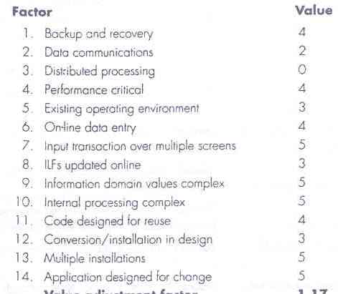
An Example of FP-Based Estimation
Value Adjustment Factors

Slide 38
An Example of FP-Based Estimation
Now,
FP_{estimated} = count_total × [0.65 + 0.01 × Σ (F_{i})]
F_{i} (i = 1 to 14 are value adjustment factors)
So,
FP_{estimated} = W = 320 × [0.65 + 0.01 × 52] = 375 (approx.)
Let,
Average Productivity = X = 6.5 FP/pm
Labor rate = Y = $8,000 per month
So,
Cost per FP = Z = Y/X = $1,230 (approx.)
Total estimated project cost = W*Z = $461,000 (approx.)
Estimated effort = W/X = 58 person months (approx)

Slide 39
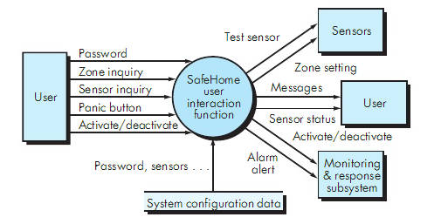
An Example
password, panic button, activate/deactivate
zone inquiry, sensor inquiry
system configuration file
messages, sensor status
test sensor, zone setting, alarm alert, a/d
Let ΣF_{i} = 46
Size in FP?
Effort?
Cost?

Slide 40
Estimating Size: Stage 3
See slides 9 to 12

Slide 41
Information System Example Piccadilly System estimate at stage 1 (Application Composition Time)
Using COCOMO II
Three screens and one report
Booking screen: complexity simple, weight 1
Ratecard screen: complexity simple, weight 1
Availability screen: complexity medium, weight 2
Sales report: complexity medium, weight 5
Low experience and low CASE maturity
Estimated effort = 1.29 person months

Slide 42
Management Activities in SE
Estimation in Agile Development (Recap)
Discussed before Mid 1

Slide 43
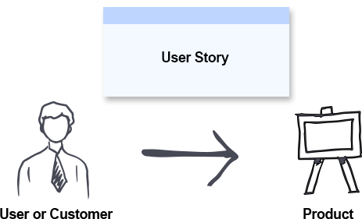
Estimation in Agile
Project Velocity
The amount of work an agile team can complete in a sprint
Story Points
The amount of effort required to implement a user story
User Story
A requirement or general explanation of software feature

Slide 44

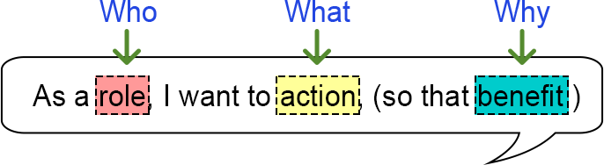
Examples of User Stories
As a [customer], I want [shopping cart feature] so that [I can easily purchase items online].
As an [manager], I want to [generate a report] so that [I can understand which departments need more resources].
As a [customer], I want to [receive an SMS when the item is arrived] so that [I can go pick it up right away]

Slide 45
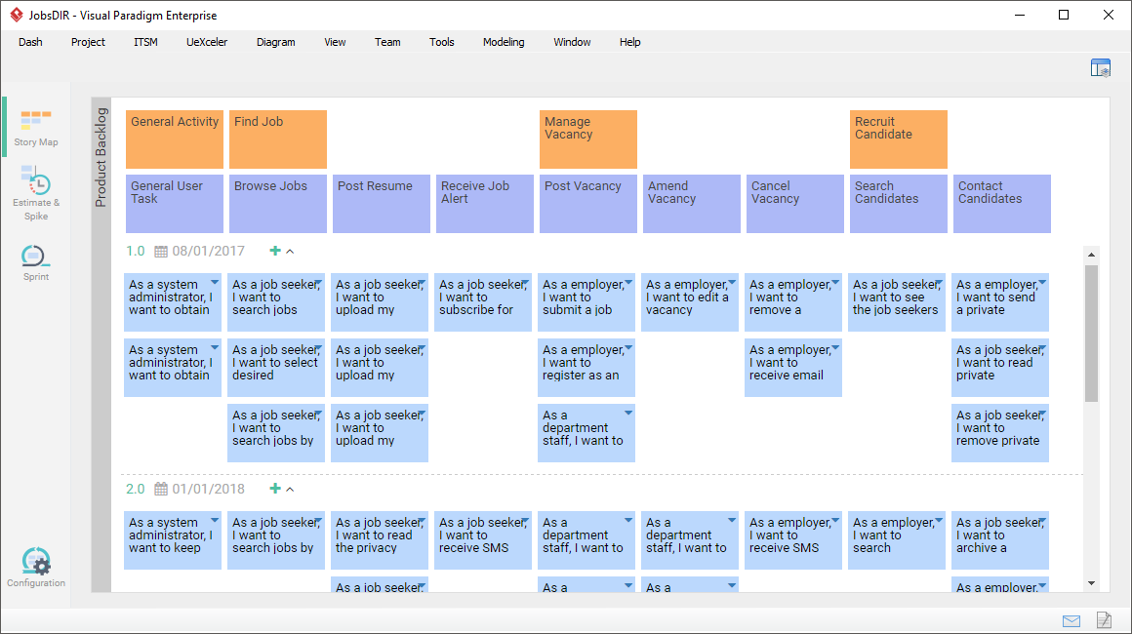
Example

Slide 46
Estimation in Agile
Project Velocity
Story points completed ÷ Number of sprints

Slide 47
References
SE by Pfleeger
SE by Pressman
UCF slides for SE course

